Slide 1

Chapter 1:
Introduction to Project Management
Information Technology Project Management, Seventh Edition
Note: See the text itself for full citations.

Slide 2
Learning Objectives
Understand the growing need for better project management, especially for information technology (IT) projects
Explain what a project is, provide examples of IT projects, list various attributes of projects, and describe the triple constraint of project management
Describe project management and discuss key elements of the project management framework, including project stakeholders, the project management knowledge areas, common tools and techniques, and project success

Slide 3
Learning Objectives
Discuss the relationship between project, program, and portfolio management and the contributions each makes to enterprise success
Understand the role of project managers by describing what they do, what skills they need, and career opportunities for IT project managers
Describe the project management profession, including its history, the role of professional organizations like the Project Management Institute (PMI), the importance of certification and ethics, and the advancement of project management software

Slide 4
Introduction
Many organizations today have a new or renewed interest in project management
Computer hardware, software, networks, and the use of interdisciplinary and global work teams have radically changed the work environment
The world as a whole spends nearly $10 trillion of its $40.7 trillion gross product on projects of all kinds
More than 16 million people regard project management as their profession

Slide 5
What Is a Project?
A project is “a temporary endeavor undertaken to create a unique product, service, or result” (PMBOK® Guide, Fifth Edition, 2012)
Operations is work done to sustain the business
Projects end when their objectives have been reached or the project has been terminated
Projects can be large or small and take a short or long time to complete

Slide 6
Project Attributes
A project
  has a unique purpose
  is temporary
  is developed using progressive elaboration
  requires resources, often from various areas
  should have a primary customer or sponsor
    The project sponsor usually provides the direction and funding for the project
  involves uncertainty

Slide 7
Project and Program Managers
Project managers work with project sponsors, project team, and other people involved in a project to meet project goals
Program: group of related projects managed in a coordinated way to obtain benefits and control not available from managing them individually (PMBOK® Guide, Fifth Edition, 2012)
Program managers oversee programs; often act as bosses for project managers

Slide 8
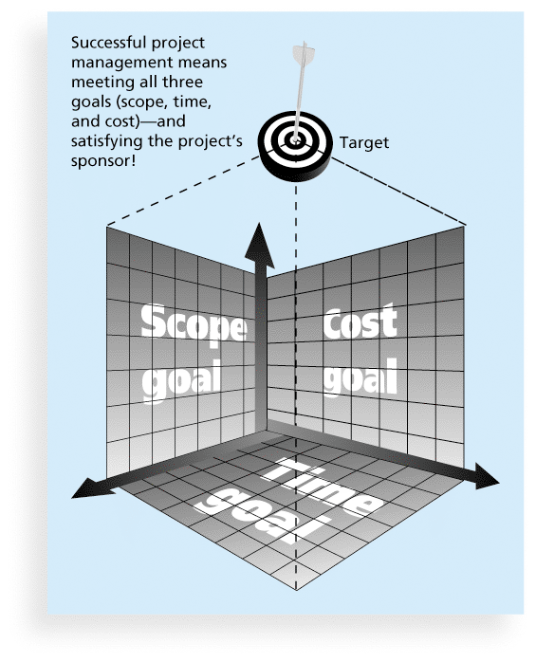
Figure 1-1 The Triple Constraint of Project Management

Slide 9
What is Project Management?
Project management is “the application of knowledge, skills, tools and techniques to project activities to meet project requirements” (PMBOK® Guide, Fourth Edition, 2012)
Project managers strive to meet the triple constraint (project scope, time, and cost goals) and also facilitate the entire process to meet the needs and expectations of project stakeholders

Slide 10
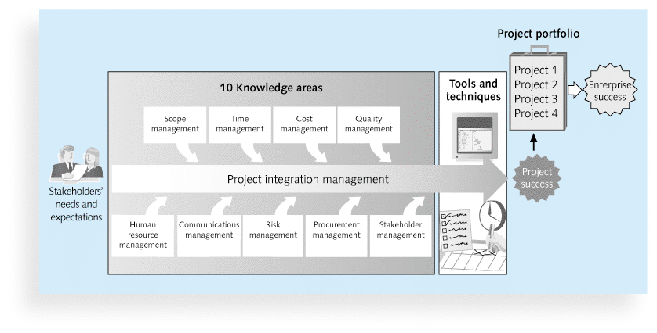
Figure 1-2 Project Management Framework

Slide 11
Project Stakeholders
Stakeholders are the people involved in or affected by project activities
Stakeholders include
  the project sponsor
  the project manager
  the project team
  support staff
  customers
  users
  suppliers
  opponents to the project

Slide 12
10 Project Management Knowledge Areas
Knowledge areas describe the key competencies that project managers must develop
Project managers must have knowledge and skills in all 10 knowledge areas (project integration, scope, time, cost, quality, human resource, communications, risk, procurement, and stakeholder management)
This text includes an entire chapter on each knowledge area

Slide 13
Project Management Tools and Techniques
Project management tools and techniques assist project managers and their teams in various aspects of project management
Some specific ones include
  Project charter, scope statement, and WBS (scope)
  Gantt charts, network diagrams, critical path analysis, critical chain scheduling (time)
  Cost estimates and earned value management (cost)
  See Table 1-1 for many more

Slide 14
Project Success
There are several ways to define project success:
  The project met scope, time, and cost goals
  The project satisfied the customer/sponsor
  The results of the project met its main objective, such as making or saving a certain amount of money, providing a good return on investment, or simply making the sponsors happy

Slide 15
Program and Project Portfolio Management
A program is “a group of related projects managed in a coordinated way to obtain benefits and control not available from managing them individually” (PMBOK® Guide, Fifth Edition, 2012)
A program manager provides leadership and direction for the project managers heading the projects within the program
Examples of common programs in the IT field include infrastructure, applications development, and user support

Slide 16
Project Portfolio Management
As part of project portfolio management, organizations group and manage projects and programs as a portfolio of investments that contribute to the entire enterprise’s success
Portfolio managers help their organizations make wise investment decisions by helping to select and analyze projects from a strategic perspective

Slide 17
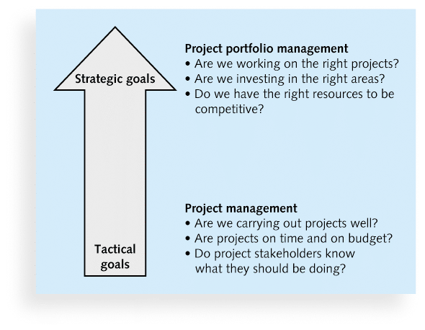
Figure 1-3. Project Management Compared to Project Portfolio Management

Slide 18
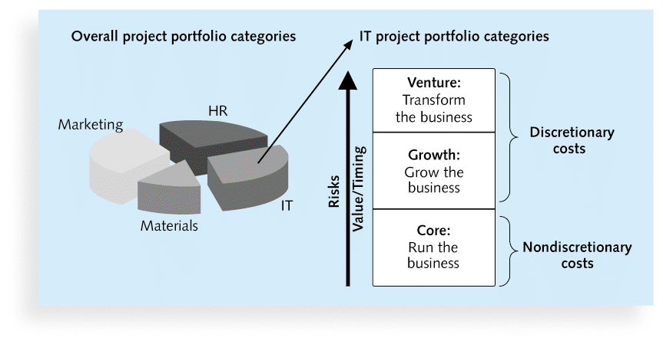
Figure 1-4. Sample Project Portfolio Approach

Slide 19
The Role of the Project Manager
Job descriptions vary, but most include responsibilities like planning, scheduling, coordinating, and working with people to achieve project goals
Remember that 97% of successful projects were led by experienced project managers, who can often help influence success factors

Slide 20
Suggested Skills for Project Managers
The Project Management Body of Knowledge
Application area knowledge, standards, and regulations
Project environment knowledge
General management knowledge and skills
Soft skills or human relations skills

Slide 21
Table 1-3 Ten Most Important Skills and Competencies for Project Managers
1. People skills
2. Leadership
3. Listening
4. Integrity, ethical behavior, consistent
5. Strong at building trust
6. Verbal communication
7. Strong at building teams
8. Conflict resolution, conflict management
9. Critical thinking, problem solving
10. Understands, balances priorities

Slide 22
Importance of Leadership Skills
Effective project managers provide leadership by example
A leader focuses on long-term goals and big-picture objectives while inspiring people to reach those goals
A manager deals with the day-to-day details of meeting specific goals
Project managers often take on the role of both leader and manager

Slide 23
The Project Management Profession
The profession of project management is growing at a very rapid pace
It is helpful to understand the history of the field, the role of professional societies like the Project Management Institute, and the growth in project management software

Slide 24
Global Issues
Several global dynamics are forcing organizations to rethink their practices:
  Talent development for project and program managers is a top concern
  Good project portfolio management is crucial in tight economic conditions
  Basic project management techniques are core competencies
  Organizations want to use more agile approaches to project management
  Benefits realization of projects is a key metric

Slide 25
Project Management Certification
PMI provides certification as a Project Management Professional (PMP)
A PMP has documented sufficient project experience, agreed to follow a code of ethics, and passed the PMP exam
The number of people earning PMP certification is increasing quickly
PMI and other organizations offer additional certification programs (see Appendix B)

Slide 26
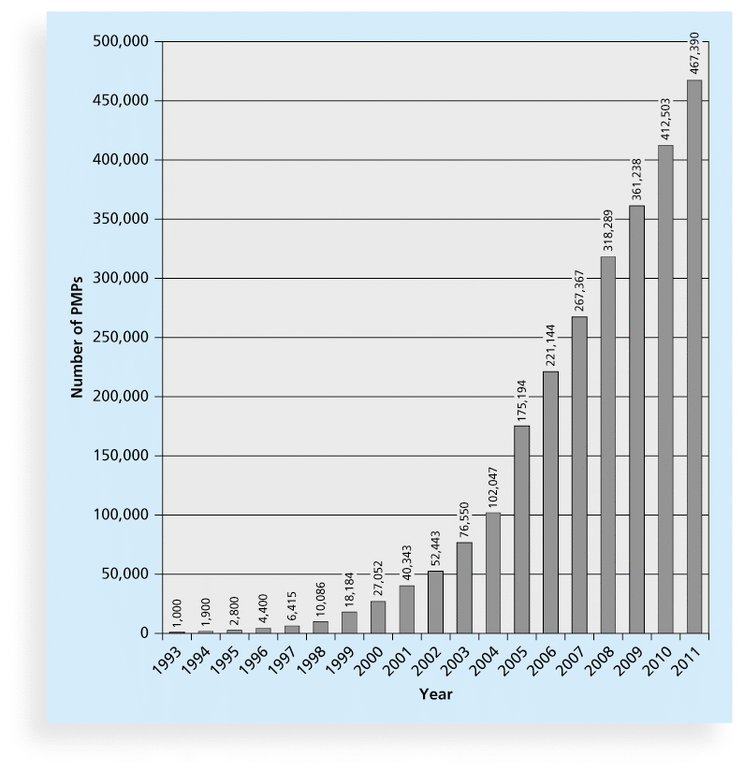
Figure 1-9 Growth in PMP Certification, 1993-2011

Slide 27
Ethics in Project Management
Ethics, loosely defined, is a set of principles that guide our decision making based on personal values of what is “right” and “wrong”
Project managers often face ethical dilemmas
In order to earn PMP certification, applicants must agree to PMI’s Code of Ethics and Professional Conduct
Several questions on the PMP exam are related to professional responsibility, including ethics

Slide 28
Project Management Software
There are hundreds of different products to assist in performing project management
Three main categories of tools:
  Low-end tools: Handle single or smaller projects well, cost under $200 per user
  Midrange tools: Handle multiple projects and users, cost $200-$1,000 per user, Project 2010 most popular
  High-end tools: Also called enterprise project management software, often licensed on a per-user basis, like Microsoft Enterprise Project Management solution

Slide 29
Chapter Summary
A project is a temporary endeavor undertaken to create a unique product, service, or result
Project management is the application of knowledge, skills, tools, and techniques to project activities to meet project requirements
A program is a group of related projects managed in a coordinated way
Project portfolio management involves organizing and managing projects and programs as a portfolio of investments
Project managers play a key role in helping projects and organizations succeed
The project management profession continues to grow and mature

